Slide 1
Save School Children from Wretched Conditions -Spend money on poor children NOT on Tokyo Olympics -
Presentation for the History NGO Forum for Peace in East Asia
on June 17th (Thu.) in 2021
Presenter: Katsuyuki Nara
Researcher at Child’s Studies Center
of Shiraume-Gakuen Junior College in Tokyo

Slide 2
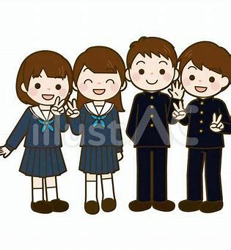
Aims of this presentation:
To reveal wretched conditions of Japanese school children from the various data such as CRC, UNICEF, and OECD.
To clarify where they really are in society
To listen to underprivileged children
To show what Japanese government should address in the future

Slide 3
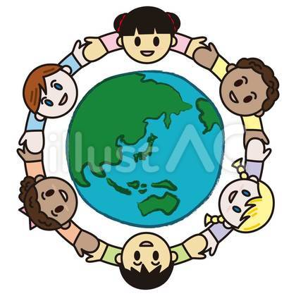
Definition of Peace
According to Johan Galtung
(Norwegian sociologist、known for principal
founder of peace and conflict studies)
Peace is defined :
Negative Peace: state of absence of war
Positive Peace : state of absence of structural
violence such as poverty,
oppression and discrimination

Slide 4
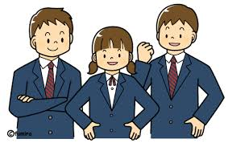
The Convention on the Rights of the Child
On 20th November in 1989,
Adopted and opened for signature and ratification by UN
On 2nd September in 1990,
Entered into force
In 1994,
Our Government ratified it, but ….

Slide 5
Japanese Govt has ignored CRC recommendations
CRC issued recommendations to our Government four times, each asking for improvement of vicious educational environment.
But… our Govt virtually ignored the recommendations,
Therefore, the students’ conditions remain unchanged or even getting worse.

Slide 6
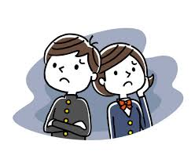
CRC Recommendation strongly urges Japan to protect their childhood
(a) Take measures to ensure that children enjoy their childhood, without their childhood and development being harmed by the competitive nature of society;
(b) Research root causes for suicide among children, implement preventive measures, and equip schools with social workers and psychological consultation services;

Slide 7
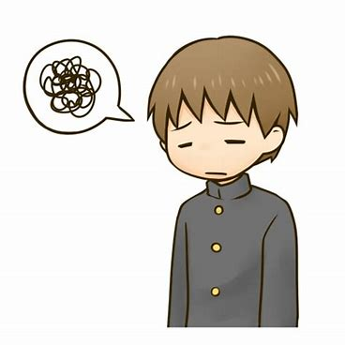
Undeniable fact in Japan A record 479 students committed suicide in 2020 (up 40 % of the previous year)！！ The Number of suicides per 100,000 population of G8 countries
Russia (42) , Japan (25), France (18), Germany (13), Canada (12) USA (11), UK (8), Italy (7)
(from the 2019 statistics compiled by the Japan’s Cabinet Office)

Slide 8
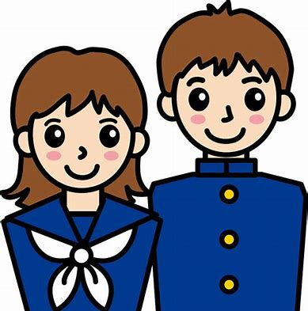
The CRC demands further……
(c) Ensure that children‘s facilities adhere to appropriate minimum safety standards and introduce ・・・・・public reviews of unexpected death.
(d) Strengthen targeted measures to prevent traffic, school and domestic accidents・・・・

Slide 9
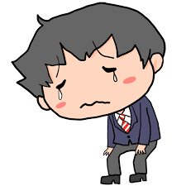
Japan ranks 20th in terms of children’s well-being (Report Card 16 of UNICEF survey)
Japan ranks 20th out of 38 countries in the Children’s Well-being ranking in developed countries.
(UNICEF announced the latest report of the "Report Card" series on September 3, 2020.
The Report Card 16 surveys “Children's well-being rankings in developed countries”):

Slide 10
A league table of child well-being outcomes: (UNICEF Statistics)
Mental well-being: includes both positive and negative aspects of a
child’s mental well-being – life satisfaction (Percentage of children with high
life satisfaction at 15) and suicide rates for 15-to19 year-olds.
Physical health: includes rates of overweight and obesity, 5-19 , which affect
children now and in future, and child mortality rate (all causes),5-14.
(Academic and Social) Skills: This dimension focuses both on academic skills
– proficiency in reading at 15 and mathematics; and social skills – feeling able to
make friends easily at school at 15..

Slide 11
A league table of child well-being outcomes: mental well-being, physical health, and academic and social skills, Japan ranks 20th!
ぃ
Overall ranking | Country | Mental well-being | Physical health | Skills | Overall ranking | Country | Mental well-being | Physical health | Skills
1 | Netherlands | 1 | 9 | 3 | 12 | Ireland | 26 | 17 | 6
2 | Denmark | 5 | 4 | 7 | 13 | Luxembourg | 19 | 2 | 28
3 | Norway | 11 | 8 | 1 | 14 | Germany | 16 | 10 | 21
4 | Switzerland | 13 | 3 | 12 | 15 | Hungary | 15 | 21 | 13
5 | Finland | 12 | 6 | 9 | 16 | Austria | 21 | 12 | 17
6 | Spain | 3 | 23 | 4 | 17 | Portugal | 6 | 26 | 20
7 | France | 7 | 18 | 5 | 18 | Cyprus | 2 | 29 | 24
8 | Belgium | 17 | 7 | 8 | 19 | Italy | 9 | 31 | 15
9 | Slovenia | 23 | 11 | 2 | 20 | Japan | 37 | 1 | 27
10 | Sweden | 22 | 5 | 14 | 21 | South Korea | 34 | 13 | 11
11 | Croatia | 10 | 25 | 10 | 22 | Czech Republic | 24 | 14 | 22

Slide 12
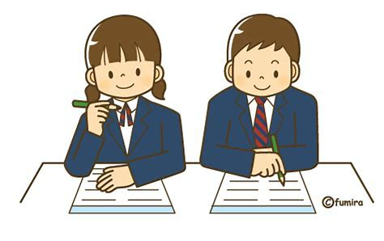
Japan Country Note of “Education at a Glance in 2015” (OECD indicators) reveals that ……
Japan’s spending per student on primary to tertiary educational institutions as a percentage of the GDP is lower than the average across OECD countries,
On average, OECD countries
spend 5% of their GDP, compared to
4.1% in Japan.

Slide 13
Japan - Country Note - Education at a Glance 2018: OECD Indicators Figure 2. Total expenditure on educational institutions as a percentage of GDP (2016)
(5%)
Ranks 31st !
(4.1%)

Slide 14
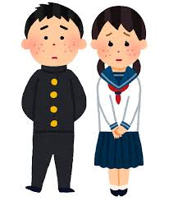
Child poverty rate …… 15% in 2015
The child poverty rate shows the percentage of children under the age of 18 who live in relative poverty.
Relative poverty is defined as having income of less than one-half the national median disposable income, which for a household of one parent and one child means a monthly income (including public assistance) of 140,000 yen (1,300 US$) or less.

Slide 15
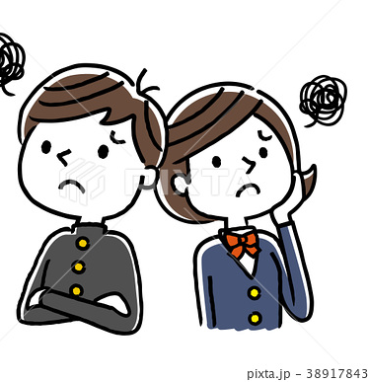
Japanese poverty rate worsens (from a study of UNICEF)
Japanese govt needs to address its child poverty problem
Japan's child poverty rate was 15% in 2015. Among G-7 nations, only the U.S. and Italy recorded higher levels.
This means that today, one in seven children in Japan lives in relative poverty -- a situation in which a household's income is at or below half the median of the total population.

Slide 16
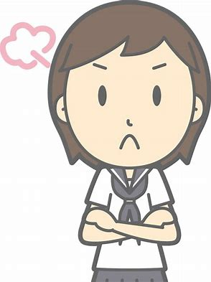
Japanese poverty rate worsens (from a study of UNICEF)
The October 17th is the UN-designated International Day for the Eradication of Poverty .
There is an understandable tendency to focus on developing countries, so it may come as a surprise that child poverty is an issue in Japan
------ the world's third-biggest economy and one of its largest donor countries.

Slide 17
The Japan’s relative poverty (16%)rate ranks 2nd high among the G7 countries… (source：OECD in 2017)

Slide 18
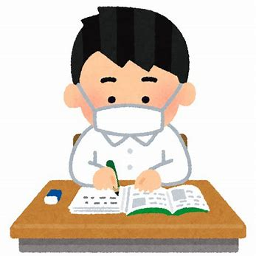
(We run) A Tuition-free Learning Support Private School for Poverty-stricken Children and average-ones in Tokyo.
* The school’s name : Wakatta-kai (Literally means “Did you get it?”)
* Established in December 2013
* Students: 10 elementary and junior-high school students
Instructors: 8 men and women
(We teach the kids every Sunday afternoon unpaid.)
………………………………………………………………………
Today these students work hard under the instructors, combating poverty and the raging Corona pandemic.

Slide 19
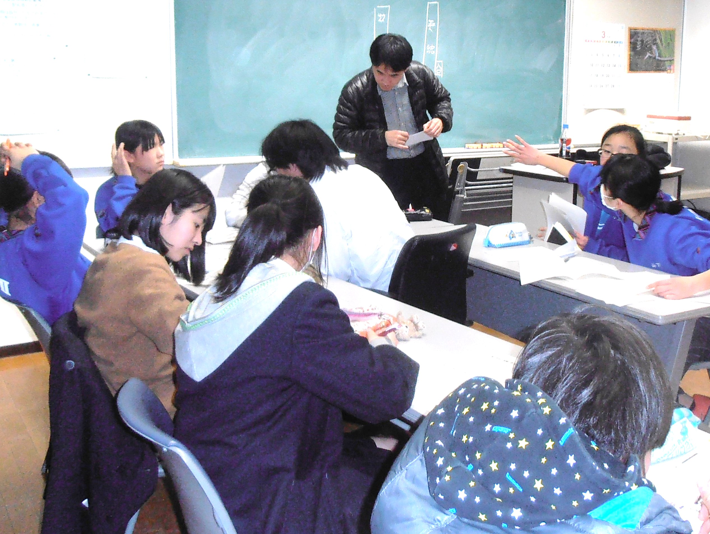
At Wakkata-kai session, The underprivileged children help themselves each other in studying, regardless of their family background, poor or rich, under the scanty government’s education expenditure, today…..

Slide 20
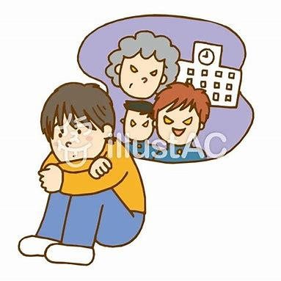
School refusers…….
In 2018, school refusers:
164,000 around the country
(at elementary and
junior high schools)
1.7 % of the registered students
( 1 school refuser for every 27
students in junior high school)

Slide 21
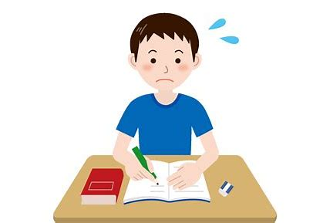
Convention on the Rights of the Child
Article 12 says.............
Children have the right to say what they think should happen.

Slide 22
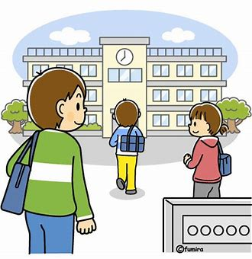
Constitution of Japan.......
Article 26 says .............
All people shall have the right
to receive an equal education
correspondent to their ability,
as provided by law.

Slide 23
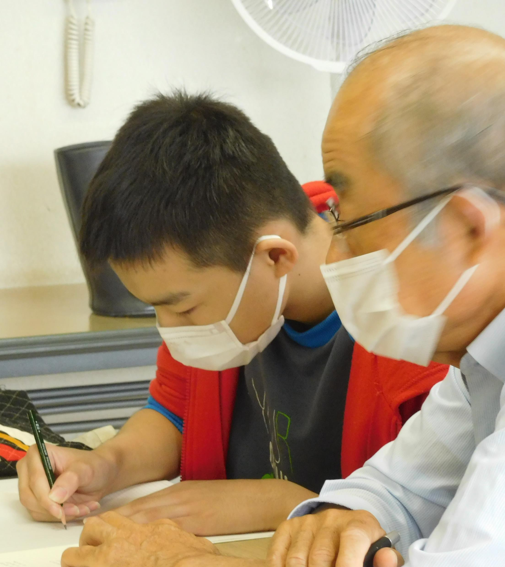
Grownups, just listen to me ! voice of a school-refuser
I live in a fatherless family--- Mom and a three-year-old sister and myself. We get a local government benefit for a living.
Mom is very mentally sick, and can’t work.
I’m a 6th grader at a local primary school, but I’ve been unable to attend it for two years since I was left behind in school.

Slide 24
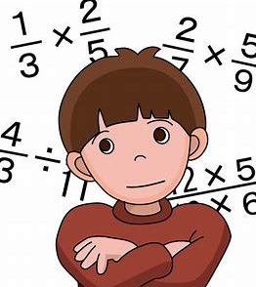
I want to be good at studies very soon! Now…..
I can only read Japanese textbooks very slowly.
I can only write a few Chinese characters.
I can’t read nor write Alphabets.
I can’t even do simple arithmetic.
But…… I want to do well at Wakatta-kai quickly!

Slide 25
Govt leaders, just listen to me!!
As a human and a child,
I have the right to study at school!
I just want to study like others, and nothing else!
I need school textbooks, notebooks, pencils, etc. now!

Slide 26
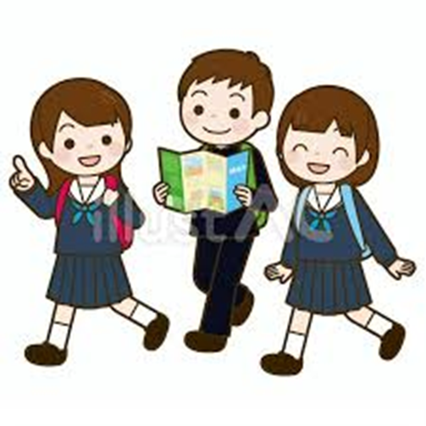
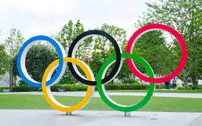
We instructors demand that the Govt should
Divert the fund of 300 billion US dollars
for Tokyo Olympics to Education

Slide 27
Finally, to Save Japanese children from wretched conditions
The Government should address
the following challenges ---
--- adhere to recommendations of CRC
--- cancel “Tokyo Olympics” and divert the
fund to Education
--- more importantly, listen to children’s voices
◎ Establish a society where every
children can fully open up their potential！

Slide 28
References :
Johan Vincent Galtung: Peace: Research – Education – Action (1975)
Reports of the Committee on the Rights of the Child
2019 statistics compiled by the Japan’s Cabinet Office
A league table of child well-being outcomes (UNICEF Statistics)
“Education at a Glance in 2018” (OECD indicators)
Survey of Japan’s Ministry of Health, Labor and Welfare
Thank you for listening!
E-mail address: ever.onward.nara@xd5.so-net.ne.jp

